Slide 1

SWISS CORPORATE SERVICES
Geneva
Corporate presentation

Slide 2

SWISS CORPORATE SERVICES
Geneva

Slide 3
Summary
Introduction
Who are we?
Philosophy
Team
Services 1+2
One single offer
Partnerships
Examples of partnerships
Contact

Slide 4
Introduction
Swiss Corporate Services is a Geneva based company founded in 2007 to provide Strategic Advisory services to Swiss and Foreign entrepreneurs with a main focus on luxury goods, horology and industries with a high added value.

Slide 5
Who are we ?
SCS s.a. is an independent and privately held company focusing on developing simple and efficient business solutions for its clients elaborated by a senior professionals with a strong sectorial expertise.

Slide 6
Our Philosophy
Personal Service
SCS’s philosophy prides itself on developing long term relationship with its clients, and partners, rooted in a deep understanding of their specific objectives and requirements
Tailor made solutions
Each customer is different. Thus our team and our partners are dedicated at providing the best suited solutions to any business requirement raised by our clients
Secrecy and compliance
As our clients, our team of professionals is sharing the highest level of discretion and confidentiality that prevails in the Swiss banking industry segment.
Transparent fee structure
SCS believes in agreeing a true and simple fee structure prior to the acceptation of a mandate. This fee structure will cover all our services, ensuring that there will be no hidden extra costs incurred during the mandate.

Slide 7
Team
Tolis Cléopas, founder
After a career in international commercial banking he occupied various management positions in finance and treasury working for Swiss and foreign multinational corporations in the areas of petro-chemical products, perfumes and cosmetics, telecommunications and intellectual property rights. Since 2005 he runs a family owned service business firm. In 2006 he teamed with a banker to develop financial services solutions for the watch industry leading the way to the creation of SCS.
Horst Edenhofer, Associate
Horst has 35 years of experience in luxury markets. He joined Cartier in1976 where he occupied various positions before his appointment as CEO of Cartier Switzerland, a position which he occupied for 13 years.
Horst is Graduated in Marketing and Econometrics from the University of Fribourg (Switzerland).

Slide 8
Services
Business Development
Strategic planning & advisory
Mergers & acquisitions
Financial structuring
Market acquisition & development support
Business Support
Financial planning & organization
Processes & Organisation optimization

Slide 9
Services (2)
Business intelligence & innovation
Market studies & development, benchmarking
Events
New technologies development advisory
Legal services and advices
Contractual matters
Company creation, structure and administration
Intellectual property
Litigation and arbitration
Tax services and optimization
Holding and offshore matters

Slide 10
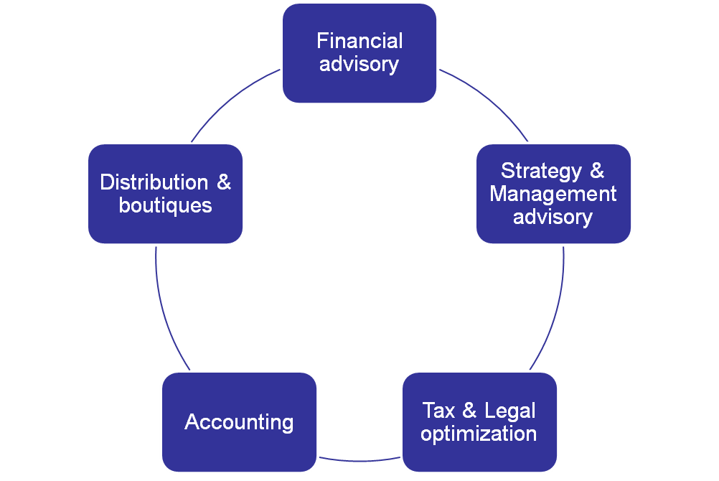
One single point of contact

Slide 11
Partnerships
SCS has engaged several strategic partnerships with Swiss and foreign companies, law firms and tax optimization companies enabling SCS to offer a wide range of specialized services with strong added value.
SCS partnership network grant a wide coverage of key strategic markets worldwide including: Europe, India and Asia-Pacific countries to offer unique business solutions to its clients.

Slide 12
Examples of partnerships
Business intelligence , innovation & marketing
Horst Edenhofer
Tolis Cléopas
Massimiliano Morpurgo
Club GS Milano
Legal services and advices
Contractual matters
Various law firms in Geneva
DS Law firm, Milano
Tax services and optimization
Various banks and lawyers in Geneva
Financial and Accounting services
DRP Geneva

Slide 13

Contact
Swiss Corporate Services S.A.
8, avenue Calas 8
1206 Geneva
Switzerland
T + (4122) 347 43 60
F + (4122) 348 28 20
Mail to : scsmanagement@bluewin.ch

